Slide 1
On-premise Monolith to Microservices in the Cloud
A 3-Phase Approach
Bryan B. Praditkul
9/2017

Slide 2
Assumptions
Organizational decisions:
Breaking up a monolith into microservices
Moving these microservices and/or the monolith into the cloud (AWS). These activities are likely to occur in parallel
Organizational needs:
Operational blueprint on how microservices will work for a high throughput SaaS business. Identify critical aspects/milestones
Plan to migrate a large monolith into the cloud. Optimize and innovate for improvements.
Plan to shift toward DevOps while the engineering team is still working in a monolith environment.
Additional Assumptions:
Organization is already using some or at least understands Agile methodologies
Organization is not opposed to operating in the cloud and/or microservices
Notes:
3 groups of assumptions

Slide 3

A Catalyst for Growth & Change
Vision
Move, pivot, grow faster
Operate reliably and efficiently
Provide higher uptime with reduced MTTR
Bring a better experience and value to our customers
Notes:
start with the why...

Slide 4

10,000ft Projection on Growth & Change
Culture/People
Team Organization
DevOps Culture of Collaboration
Process Improvement
Feedback cycle and Continuous Improvement
Technology
Architecture
Data and Storage
Security and Privacy
API Management
Monitoring and Alerting
CI/CD/CD
Notes:
High level of what the team can expect for progressive change
More of a transformation (team, culture, process improvement in addition to tech)

Slide 5
Phase I. Why “Some” DevOps First?
Culture/People
Team Organization
DevOps Culture of Collaboration
Process
Feedback cycle and Continuous Improvement
Technology
Architecture
Data and Storage
Security and Privacy
API Management
Monitoring and Alerting
CI/CD/CD
DevOps:
A cultural movement of communication, collaboration, and integration between Dev and Ops while automating the process of software and infrastructure changes to bring value to end users
…that is applicable to many technologies and organizations
Notes:
Whether cloud, microservice, monolith, DevOps brings value to any organization
The question is what are the applicable for a monolith
What do we apply for a monolith going through a major transition?

Slide 6
DevOps Principles in Practice – What can we apply?
Automated Testing
Continuous Integration
Continuous Deployment
Automated Release Management
Blue/Green Deployments
Chat bots
Usage Monitoring
Telemetry Collection
Testing in Production
Stakeholder Feedback
RCA outcomes
Peer Code Reviews
Automated Testing
Continuous Measurement
Agile Documentation
Security
Infrastructure as Code
Configuration as Code
Leverage Cloud services
Automatic Scaling
Proper environments
Containerization
Microservices Architecture
Chat bots
Flow of Customer Value
Autonomy and Alignment
Backlog improved by learning
Evidence gathered in production
Technical
Debt
Control
Live Environment
Mindset
Flexible
Infrastructure
Experiments
Testing in Production
Usage Monitoring
User Telemetry
Stakeholder feedback
Feature flags
Self Healing
Infrastructure as Code
Shift-left accountability
Continuous Delivery
Release Management
Configuration as Code
Application Performance Management
Agile/Kanban
Journey Teams
Cross Team Collaboration
Communication
Notes:
consider some practices that we can put in place to address the principles that can be applied early on even in a monolith
depending on the org, there might be others that can be implemented

Slide 7
Continuous Process and Culture for a Monolith
Functional Quality
Code Quality
Continuous Deployment
Continuous Delivery
Monitor & Measure
Create Environment
Build Confidence
Continuous Integration
Requirements
Code
& Review
Build
Configure & Deploy
Test
Check & Promote to Prod
Effective Branching
Feedback
Fail Fast
Process Quality
Continuous feedback on technology, culture, documentation, and measurement
Notes:
With Git at the least branch by environment
And jenkins (start automating parts of the build), think about dependencies (whether they can be moved to cloud first (eg Artifactory)
Think about possibly moving jenkins to cloud
Code quality addressed first, functinal and process quality will be addressed once in cloud
While “continuous feedback” is often related to tech, it’s important to note that there’s an equal if not great weight on culture, doc, and measurement

Slide 8
Phase II. Why Move to the Cloud?
Culture/People
Team Organization
DevOps Culture of Collaboration
Process
Feedback cycle and Continuous Improvement
Technology
Architecture
Data and Storage
Security and Privacy
API Management
Monitoring and Alerting
CI/CD/CD
Cloud
Notes:
Why a forklift to Cloud next?
Cloud platforms like AWS lay the framework to ease into many principles of DevOps
Basic cloud advantages: Flexibility, Elasticity, Cost Controls (if done properly), Collaboration, Ease of use, and security (if done properly)

Slide 9
Migrating to the Cloud
Assessment
Cost Evaluation
Architecture
Security/Privacy (BAA?)
POC
Formalized Training
MVP
Data Migration
Sensitivity of data (eg PII, etc)
Application Migration
Forklift Application through envs (VM/AMI)
Mitigate on-premise dependency conflicts
Up/Downstream Dependencies
Subnets/VPC Strategy
Implement early if possible
VPC configuration
Security Groups
DNS
Data migration services
Evaluate Storage Options
Privacy & Compliance
Basic Testing
Source: http://media.amazonwebservices.com/CloudMigration-main.pdf
Notes:
4 stages up till the heavy lift of the app into the cloud

Slide 10
Monolith On-prem
Phase II Preparations:
Simplify as much as possible
VM to AMI
DNS
SGs, Storage, Initial Sizing
Don’t forget Security and Privacy
Importance of Training
DNS
F5
Web
Web
Web Pool
Private Network
F5
App
App
App Pool
DB
Master
DB Slave
Notes:
Assume code is already being checked into Github and CI is already implemented.
Recap on some of the basic steps on a typical stack arch

Slide 11
Monolith in the Cloud
Observe:
Resource Usage
Scaling Needs/Patterns
Immediate Sunset vs Retain
Hybrid interim
Parallel deploys
Region A, AZ-1
DNS
ELB
VPC
Web
Web
Web ASG
Region A, AZ-2
ELB
S3
App
App
App ASG
RDS
Slave
RDS
Master
Cloudwatch
On-Prem Services
On-Prem Services
On-Prem Services
Notes:
Here’s the newly forklifted sample monolith in cloud
Focus on some basic areas…

Slide 12
Post Migration Critical Milestones
Build/promote healthy practices
Learn and share
Culture
Sunset or Retain
Performance
Efficiency
Monitor/Alerting
Review Utilization
Optimization
Automate/Job scheduling
Configure autoscaling
Test, Scale, and Automate
Validate resource expectations
Validate compliance
Security and Resources
Config Mgmt
Logging/monitoring
Incidence response
Tagging Strategy
Test for throughput and capacity
Cloud tools (SM, Inspector, Code Analysis, etc)
Notes:
4 critical stages post migration…
The primary gist of the 1st 3 of these last stages is focused on measurement and proper scaling to accommodate the traffic patterns and meeting SLAs

Slide 13
Phase III. Why Move to Microservices?
Defined service boundaries
Isolated functionality deployments
Provisioned for horizontal scale
Fewer tech stack boundaries
Single change won’t break the entire app!
Notes:
Vs:
One huge, slow moving monolith
High risk deployments (all or nothing)
One change can bring down the entire app
Scale is usually vertical
Tech choice is limited (or ends in hard to isolate division where tools are spread everywhere)

Slide 14
Migrating from Monolith to Microservices
Culture/People
Team Organization
DevOps Culture of Collaboration
Process
Feedback cycle and Continuous Improvement
Technology
Architecture
Data and Storage
Security and Privacy
API Management
Monitoring and Alerting
CI/CD/CD
Microservices
Notes:
Now that most of the team is comfortable with the majority of change, we are ready to consider the most drastic of changes…team organization
Introducing this split this late insures that most individuals have had time to learn and share some common practices

Slide 15
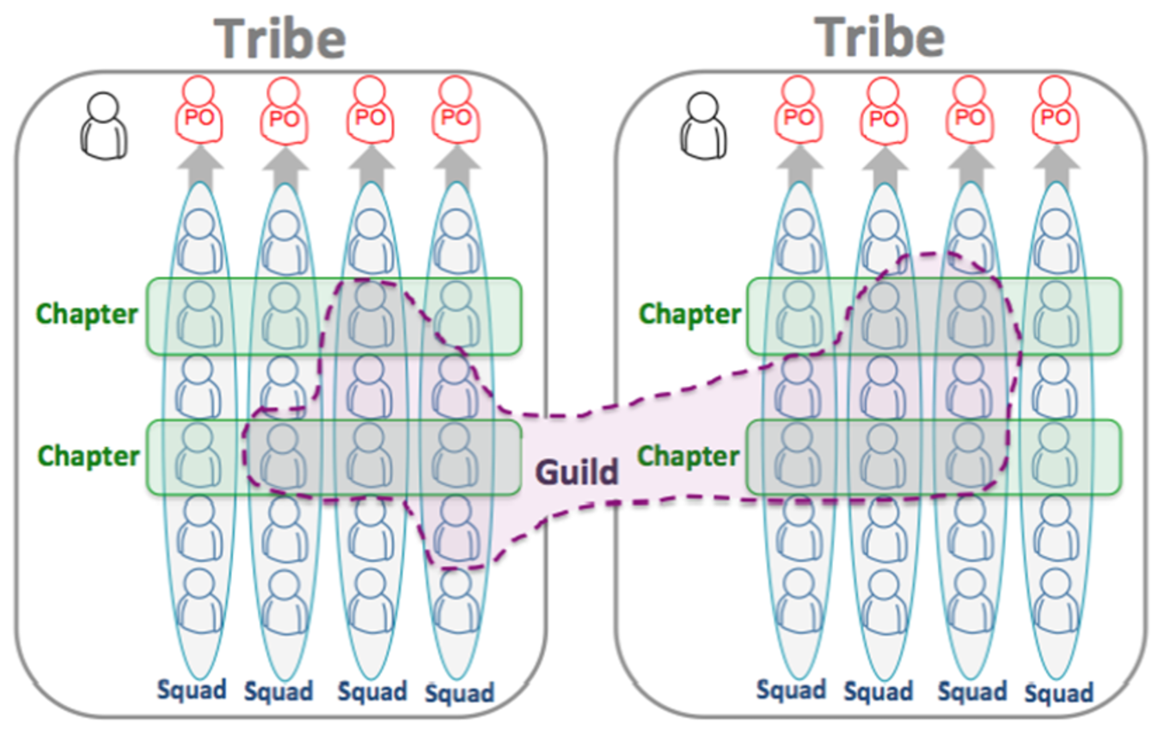
Reorganize into Teams
Team responsibilities
Gather Requirements
Source code
Tech stack and tools
Automation
Security
Deployability
Scalability
Test Quality
Source: Henrik Kniberg and Anders Ivarsson – 2012
Notes:
Spotify’s Journey Team model heavily focused on outcomes over features…
To apply this for our intentions,
Tribe is the overal product/channel (focused on delivery/quality)
Squad is the journey team that works on a particular flow(s)/service(s). They are responsible for:…..
Chapter are the competency areas QA, DevOps, Development, UX/UI
Guild are team leads or interested members who cross JTs to learn about topics/practices
Guilds change from time to time.
Squad responsibilities may grow or diminish depending on the maturity of the service or arch of the flow.

Slide 16
Migration Approach in Cloud
Gateway
Gateway
Gateway
Original
Monolith
Original
Monolith
Original
Monolith
Service
Service
Service
Service
Service
DB
DB
DB
DB
DB
DB
DB
DB
Strangler Method
No new services
Mechanism for data integrity
Introduce an API Gateway to throttle traffic
Convert smaller services first
Convert more complicated services
Repeat until monolith is gone
Service
Service
Service
DB
DB
DB
Original
Monolith
Notes:
Here’s one typical approach to moving to microservices in cloud
Connect Mechanism for data integrity across old/new-> REST APIs, RSS-like subscriptions, publish/subscribe message queues
Some Pattern/antipatterns:
Router should not be in old app
New app should not know of old app

Slide 17
Architecture
Partner with Application Architecture Team
Review monolith architecture
Identify major/minor functionalities
Eg. Config, reporting service, user service, registration, auth service
Identify critical flows
Identify unavoidable on-prem dependencies
12 Factor App considerations
12 Factor App
Codebase
Dependencies
Config
Backing Services
Build/Release/Run
Processes
Port Binding
Concurrency
Disposability
Dev/Prod Parity
Logs
Admin Processes
Notes:
With that approach in mind, we start methodically
1st work with architecture

Slide 18
12 Factor App
I. Codebase One codebase tracked in revision control, many deploys
II. Dependencies Explicitly declare and isolate dependencies
III. Config Store config in the environment
IV. Backing services Treat backing services as attached resources
V. Build, release, run Strictly separate build and run stages
VI. Processes Execute the app as one or more stateless processes
VII. Port binding Export services via port binding
VIII. Concurrency Scale out via the process model
IX. Disposability Maximize robustness with fast startup and graceful shutdown
X. Dev/prod parity Keep development, staging, and production as similar as possible
XI. Logs Treat logs as event streams
XII. Admin processes Run admin/management tasks as one-off processes
Notes:
Heroku’s Methodology for producing saas apps (minimize setup time, clean for portability, practices for scaling)
1 each app in a different repo; don’t share code; separate the deploys into each environment (branch)
2 all code has some dependency; never assume existence; insure that dependencies are there
3 keep the config outside of the application
4 service (eg db, memcache) should be referenced by a simple endpoint (so they can be swapped out)
5 all the stages are run separately (build is the heavy lifting, run should be simple, no cleanups)
6 every app should be stateless (no session…rather submit to memcache or db), no sticky sessions
7 the apps should be self contained, and should be able to hit through one url
8 to scale, lots of little processes handle specific needs, reduces complexity, now increases concurrency
9 startup/shut down should be fast (and it should clean itself), after a crash, it should start up immediately
10 all env should be the same (including dev env on laptop)
11 logs should be streamed to another service; log everything (even mundane) – helps with trends
12 one-time scripts for admin tasks should be run on a production machine, just as the app would.

Slide 19
Data and Storage
Identify the right AWS choice for db and storage
Which is the lowest impact to schema
Scalability
Security and Encryption (Data at Rest, Data in Transit)
Eg. S3 vs EBS vs Glacier vs Instance Store (Storage Gateway, Snowball, Cloudfront)?
Eg. RDS vs DynamoDB vs Elasticache?
S3
EBS
Glacier
Snowball
Storage Gateway
DynamoDB
Elasticache
RDS
Notes:
Consider the storage needed for the data each of the services
S3 vs rds if open to the public
Data migration services (db source to target), define throughput

Slide 20

Security and Privacy
Service Isolation
Role Based access (eg IAM roles)
Least Privilege (for normal operations)
OS Security updates
Audit/Access log monitoring (eg Cloudwatch/CloudTrail)
Keep services outside of any public network (eg API Gateway)
Compliance with data privacy policies by region
Don’t forget about cloud security!
Notes:
Consider a strong emphasis on security and privacy (since we’re bound by PCI, HIPAA, PII, SOC2, etc)
Think about decisions like: Api gateway is public, where to put services/elbs/etc…
Netflix bless – ssh cert authority

Slide 21
API Management
Traffic Management for failover and canary testing
Authentication and access control
Version management
Monitoring
Opportunity to re-evaluate the backend technology eg. serverless/ec2/ecs/eb/etc
Reduce latency with edge location performance
API Gateway Cache
Lambda
API Gateway
EC2
Cloudfront
Cloudwatch
Other Endpoint
Notes:
API Management is what ultimately will allow for a gradual move to microservices, so we need to put considerable effort into proper setup

Slide 22
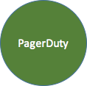
Monitoring, Testing, and Alerting
Monitoring Facets
Synthetic
Cloud Infrastructure
Real User Experience
Geographic
Application Exceptions
Log/Trend Analysis
Security
Application and Environment Monitoring
Synthetic: Simulate user requests
Cloud Infrastructure: system/network monitoring
Real User Experience: Inspect actual user traffic
Geographic: outside-in perspective
Application Exceptions: application health
Log Analysis: log trending/analytics as an event stream
Security: vulnerability, pen-testing
PagerDuty: notification system
What do we do?
Notes:
While many monitoring facets many remain the same (or similar), consider a primary that changes “event streaming”
Elasticsearch, Splunk, etc
Loosely related, also consider more destructive cloud testing measures like: Simian army – chaos monkey for testing

Slide 23
Sample New User Registration
Auth Service
Account Service
Elasticache
RDS
API Gateway
VPC
KMS
Cloudwatch
Config Service
Reporting Service
DynamoDB
S3
Lambda
On-Prem Services
On-Prem Services
Monolith
Notes:
Here’s a sample flow that could’ve come from a discussion with architecture team, keeping the earlier measures in mind…
Read counter clockwise, these are the services that could’ve been considered
Account: login/pass, kms for encryption across services, stores in DB, may have some on prem dependency still
Auth: temporary authentication across services, 24hr token stored in elasticache
Config: follows 12factor, don’t store config with app, stores attributes in dynamodb
Reporting: event streams go to ELK or S3/Athena, Cloudwatch by custom metrics via lambda
Consider Terraform
Proper vpc based on data
If we need to flip back, API gateway is configured to point back to monolith
We would repeat that for each workflow until the monolith is gone

Slide 24
Where does this put us?
Bring a better experience and value to our...
Notes:
So with those 3 phases, we would finish a chapter…
Aside from the earlier benefits mentioned for Cloud and Microservices,
This will position us to move forward faster, scale and operate more reliably, and with higher uptime
but the journey continues.
As with Devops, never done...continual improvement, …continue to bring a better experience and value to our customer

Slide 25
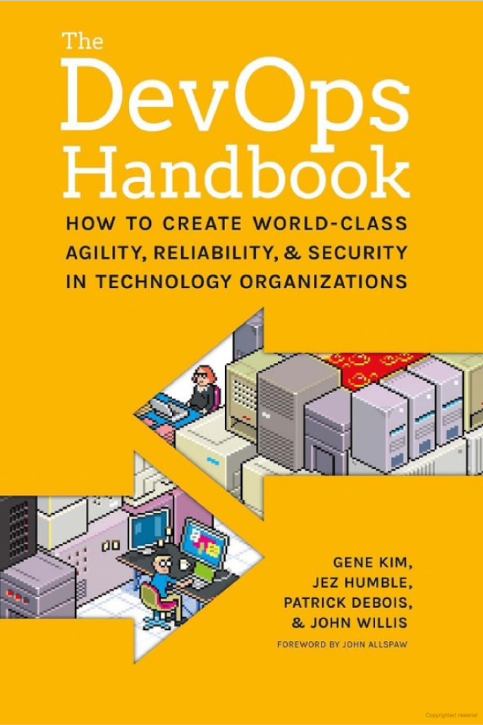
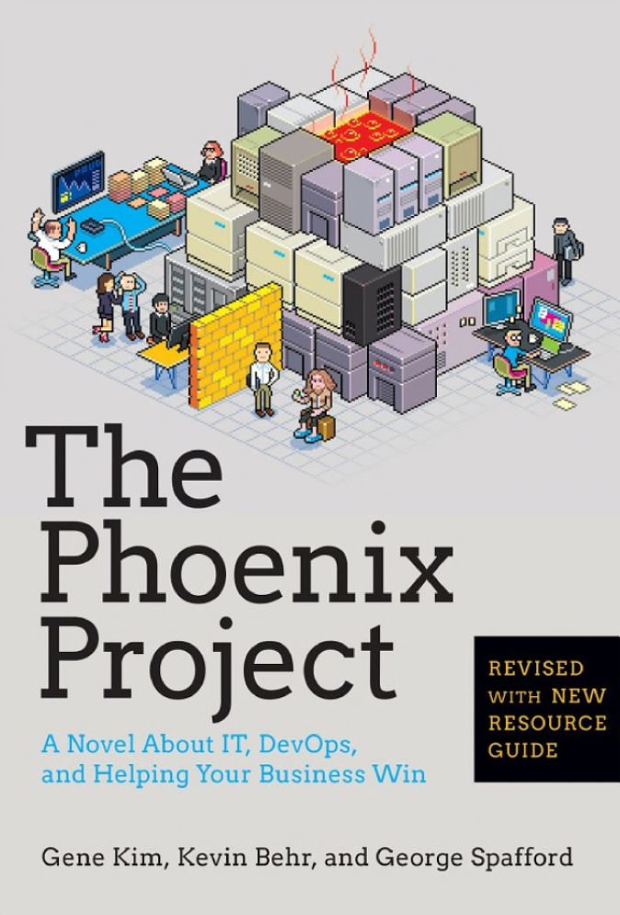
References
https://thenewstack.io/from-monolith-to-microservices/
http://media.amazonwebservices.com/CloudMigration-main.pdf
https://aws.amazon.com/whitepapers/storage-options-aws-cloud/
https://blog.runscope.com/posts/monolith-microservices-transforming-real-world-ecommerce-platform-using-strangler-pattern
https://www.slideshare.net/AmazonWebServices/aws-reinvent-2016-from-monolithic-to-microservices-evolving-architecture-patterns-in-the-cloud-arc305
https://12factor.net/

Slide 26
Q & A

Slide 27
Addendum

